Slide 1

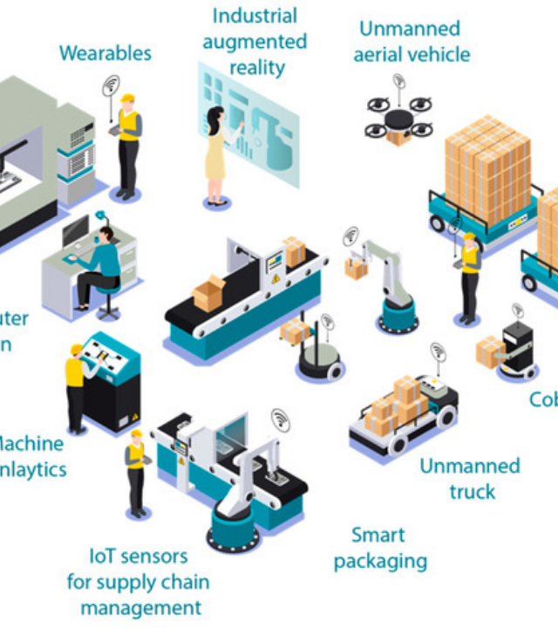
IoT-Driven Machine Monitoring
Predictive Maintenance for Small Production Units
Modernizing small production units effectively.
Moving from reactive to predictive maintenance.
Real-time visibility into machine health and status.

Slide 2


Cost of Unplanned Downtime
Small factories often rely on inefficient "run-to-failure" models.
Manual inspections are expensive, infrequent, and highly prone to human error.
Unexpected motor or CNC breakdowns cause severe production bottlenecks.
A single failure halts the entire assembly line, resulting in massive financial loss.

Slide 3










Real-Time Predictive Maintenance
Hardware
Sensors
Edge Compute
Dashboard
ESP32 Microcontroller retrofitted non-invasively onto existing machinery.
Continuous 3-axis vibration and precise temperature tracking capabilities.
On-device signal smoothing and anomaly filtering to reduce noise.
Cloud or local network dashboard providing instant alerts and analysis.

Slide 4




Data Processing & Algorithms
Signal Filtering & Checks
Vibration Energy Metric
Moving Average Filter: 5-point smoothing eliminates temporary noise (e.g., accidental bumps).
We calculate the Root Mean Square (RMS) of 3-axis vibration to detect bearing wear and shaft imbalance:
Plausibility Checks: Hard-coded thresholds automatically discard physically impossible sensor readings.
Edge Processing: Reduces server load by transmitting only clean telemetry.
Industry-standard indicator of mechanical health.

Slide 5
End-to-End Data Pipeline
1. IoT Node (C++)
2. Backend (Node.js)
3. Frontend (HTML/JS)
Sensors sample data, the ESP32 performs edge-cleaning, and transmits a JSON payload via HTTP POST over WiFi.
A REST API receives the request, strictly validates the payload structure, and stores records in an SQLite database.
The client polls the API, calculates KPI status logic, and beautifully renders real-time tracking charts.

Slide 6
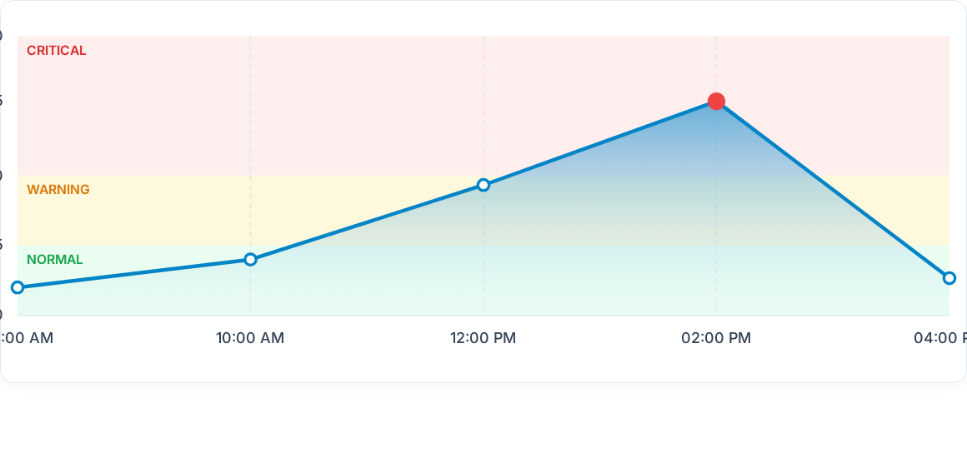
Live System Dashboard Trend
Operators receive immediate visual feedback. The system effectively identified a critical peak (red zone), allowing for maintenance scheduling before failure.

Slide 7
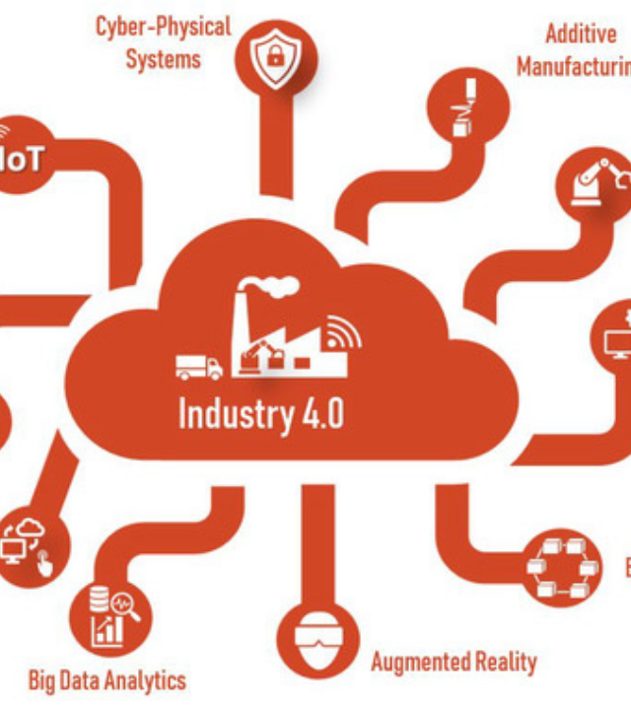
Future Enhancements
Successfully implemented robust, real-time edge monitoring.
AI Integration: Training a Machine Learning model on historical SQLite data for advanced pattern recognition.
Alert Systems: Adding automated SMS and Email alerts for off-site operators and plant managers.
Scalability: Deploying sensor nodes across the entire factory floor to create a centralized Smart Hub.

Slide 8
REFERENCE AND USEFUL LINKS
Wokwi ESP32 Simulator: The free online tool used to simulate the hardware.
MPU-6050 Datasheet: Information about the 3-axis accelerometer used to detect vibrations.
Node.js & Express.js: The software powering our backend server.
Chart.js: The library used to draw the beautiful live graphs on the dashboard.
ISO 10816 Standard: The industrial standard for evaluating machine vibration (why we use the "RMS" calculation).

